Slide 1



MINI PROJECT
ROBIN NGUYEN

Slide 2
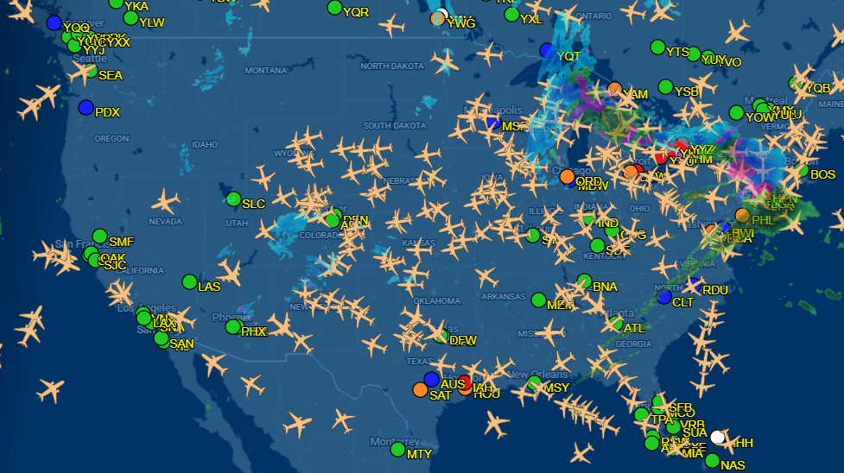
CURRENT STATE

Slide 3

INITIAL QUESTION
Airline collaboration & on‑time performance
Initial idea: compare high‑end vs low‑end airlines on how they market on‑time reliability versus the actual delays passengers experience.
Problem: flights are often sold by one brand but operated by many partners / codeshares, and delay causes (carrier, weather, NAS, security, late aircraft) are mixed together.
How does the collaboration between U.S. marketing carriers and their operating partners affect flight delay patterns, and does this undermine or support the reliability that airlines advertise?

Slide 4
DATASET
Dataset:
On‑Time Performance – Marketing Carrier (2018–present)
Problem:
Marketing vs operating carriers are stored in different columns (MKT_UNIQUE_CARRIER, BRANDED_CODE_SHARE, OP_UNIQUE_CARRIER).
Codeshares are sometimes marked only by a suffix like _CODESHARE, so you must decode that structure yourself to identify collaborations.
Solution:
Defined codeshares and filtered them to analyze collaboration separetly

Slide 5
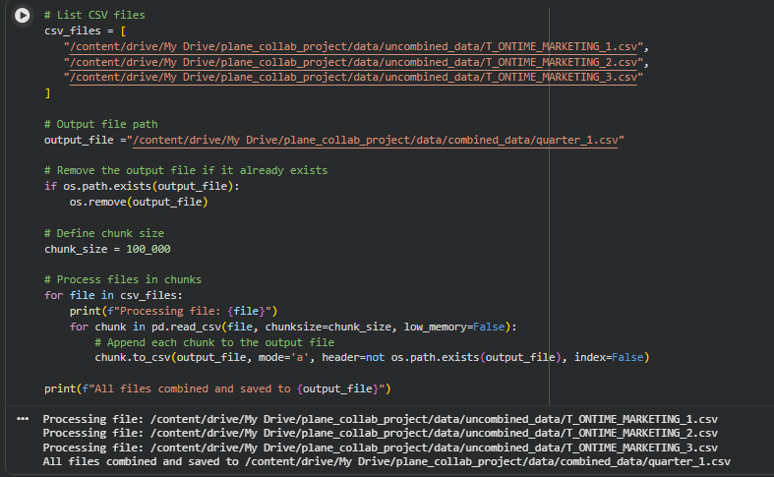
DATA RETRIVAL

Slide 6
DATACLEANING
Before:
1.8 million rows with 36 columns
Included FL_DATE and several delay‑cause columns with NaN.
Some scheduled‑operator ID fields missing.
After:
Dropped FL_DATE (date already encoded by YEAR, MONTH, DAY_OF_MONTH).
Filled missing delay‑cause fields (CARRIER_DELAY, WEATHER_DELAY, NAS_DELAY, SECURITY_DELAY, LATE_AIRCRAFT_DELAY) with 0 minutes.
Checked data types, null counts, and basic info with a check_df( ] helper.

Slide 7
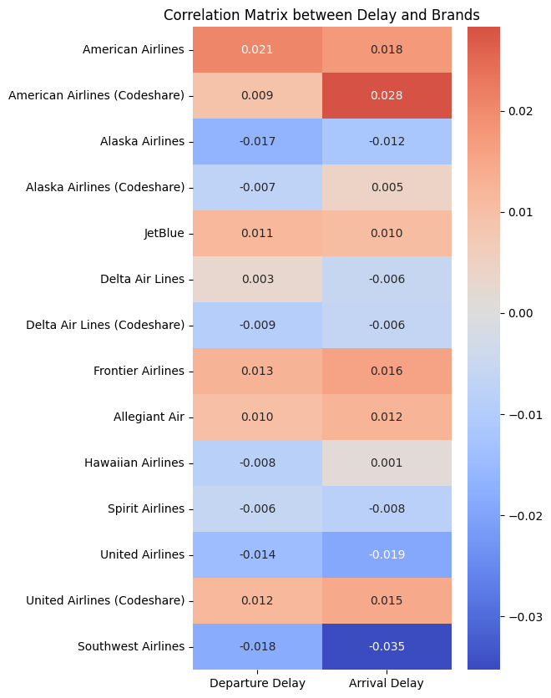
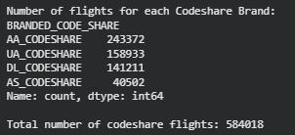

Slide 8
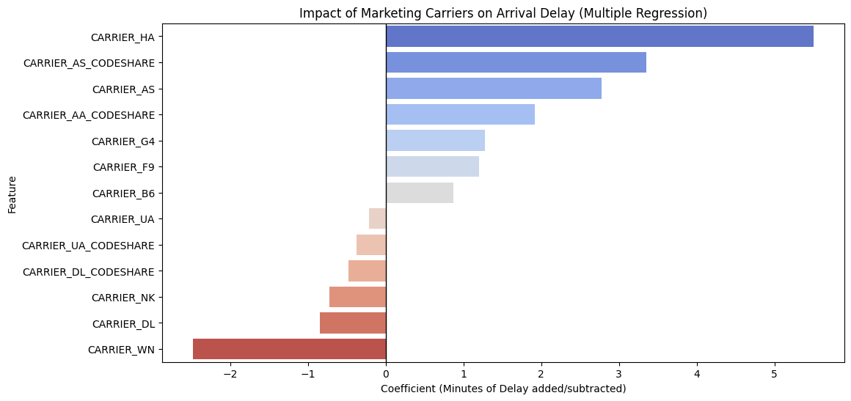

Slide 9
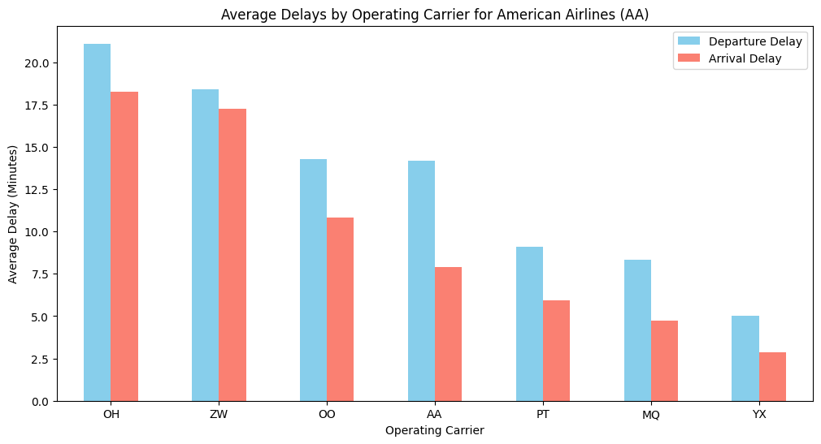

Slide 10
IMPLICATIONS FOR STAKEHOLDERS
Major airlines & marketing teams:
Can check whether advertised reliability aligns with the delays delivered by regional partners.
Identify high‑delay collaborations and target them for schedule adjustments, contract changes, or operational support.
Regional / codeshare partners:
See how their on‑time performance compares with other partners for the same marketing brand.
Use this as evidence for negotiation or for prioritizing operational improvements.
Passengers:
Can view what the quality of each major airline and their codesharers.
Could lead to more transparent tools (e.g., show historical delay by operating carrier at booking).

Slide 11
ETHICAL, LEGAL, SOCIETAL IMPLICATIONS
All flight records come from BTS, a public government source—no passenger‑level or personal data.
Delays can be caused by weather, air traffic control (NAS), security, late aircraft, not just the airline.
Regional partners often serve smaller communities; penalizing them purely on delay metrics without context could reduce service.

Slide 12
NEXT STEP
Extend beyond 2025 Q1 to full 2018–2023 training / 2024–2025 evaluation, as planned.
Explicitly classify airlines into high‑end vs low‑end and compare:
delay levels,
sensitivity to partner performance,
persistence of delay shocks using time‑series models (e.g., SARIMAX).
Add geographic analysis:
group flights by region or state clusters and see how collaboration patterns differ spatially.

Slide 13

THANK YOU

